Slide 1



Todas
View in Power BI
Last data refresh:
29/03/2022 19:00:19 UTC
Downloaded at:
29/03/2022 19:01:00 UTC

Slide 2
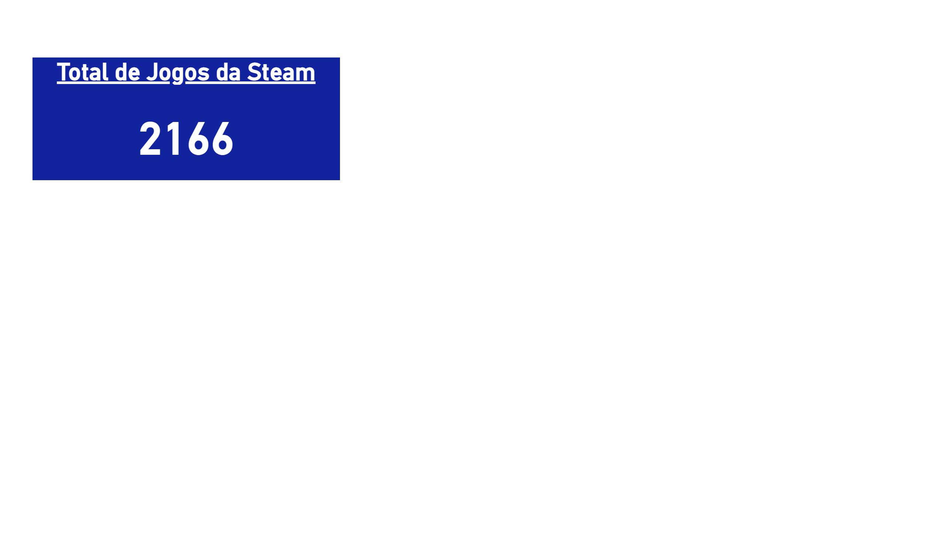
1- Total de Jogos
Notes:
Total de Jogos da Steam
No alt text provided

